Slide 1
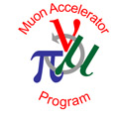

Hybrid Methods for Simulation of Muon Ionization Cooling Channels
Josiah D. Kunz
Thesis Defense
August 24th, 2016

Slide 2
Outline

Slide 3
Outline
Motivation
Fundamental particle physics
The Higgs Boson
Neutrinos
Muon facilities

Slide 4
Outline
Motivation
Fundamental particle physics
The Higgs Boson
Neutrinos
Muon facilities
Introduction to COSY Infinity
Transfer map methods
Transfer map example

Slide 5
Outline
Motivation
Fundamental particle physics
The Higgs Boson
Neutrinos
Muon facilities
Introduction to COSY Infinity
Transfer map methods
Transfer map example
Stochastic Processes
Ionization cooling
Why not use transfer maps?
Energy straggling
Multiple scattering
Transverse Displacement
Time-of-Flight

Slide 6
Outline
Motivation
Fundamental particle physics
The Higgs Boson
Neutrinos
Muon facilities
Introduction to COSY Infinity
Transfer map methods
Transfer map example
Stochastic Processes
Ionization cooling
Why not use transfer maps?
Energy straggling
Multiple scattering
Transverse Displacement
Time-of-Flight
Results
Benchmarking
Validation
MICE

Slide 7
Outline
Motivation
Fundamental particle physics
The Higgs Boson
Neutrinos
Muon facilities
Introduction to COSY Infinity
Transfer map methods
Transfer map example
Stochastic Processes
Ionization cooling
Why not use transfer maps?
Energy straggling
Multiple scattering
Transverse Displacement
Time-of-Flight
Results
Benchmarking
Validation
MICE
Summary

Slide 8
Outline
Motivation
Fundamental particle physics
The Higgs Boson
Neutrinos
Muon facilities
Introduction to COSY Infinity
Transfer map methods
Transfer map example
Stochastic Processes
Ionization cooling
Why not use transfer maps?
Energy straggling
Multiple scattering
Transverse Displacement
Time-of-Flight
Results
Benchmarking
Validation
MICE
Summary

Slide 9
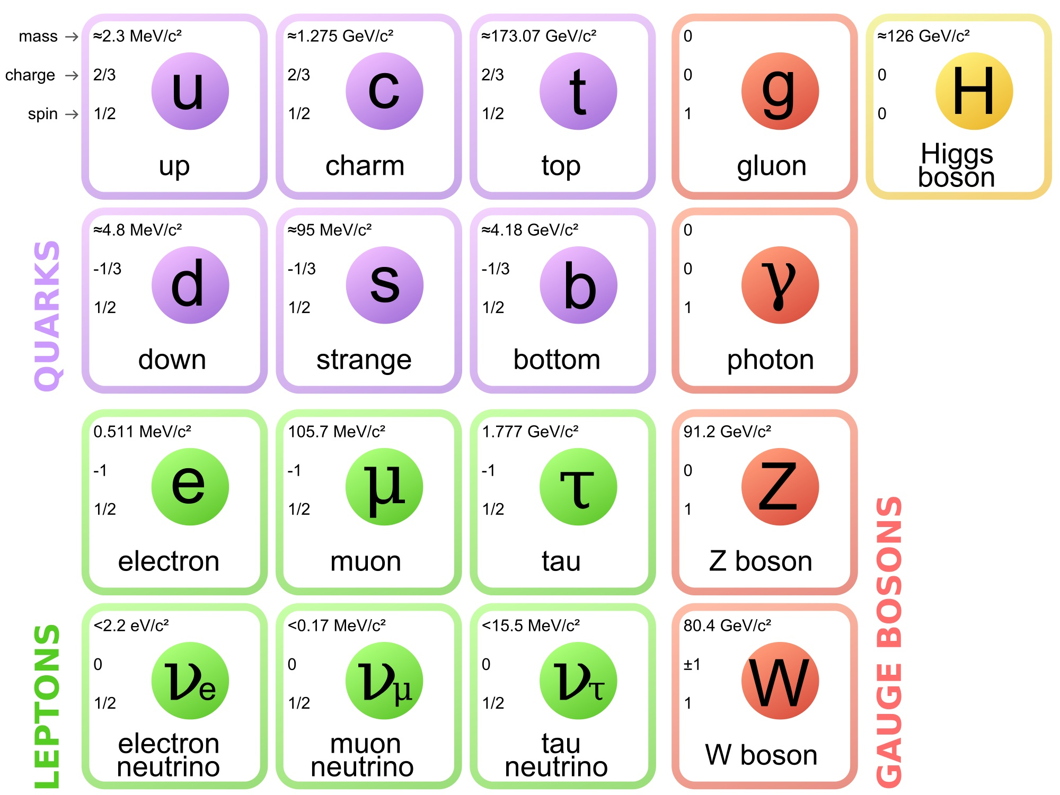
Motivation: Fundamental Particle Physics
Protons, neutrons
Interesting fundamental particles!

Slide 10
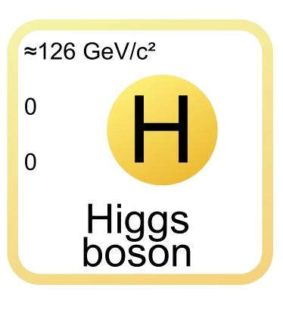
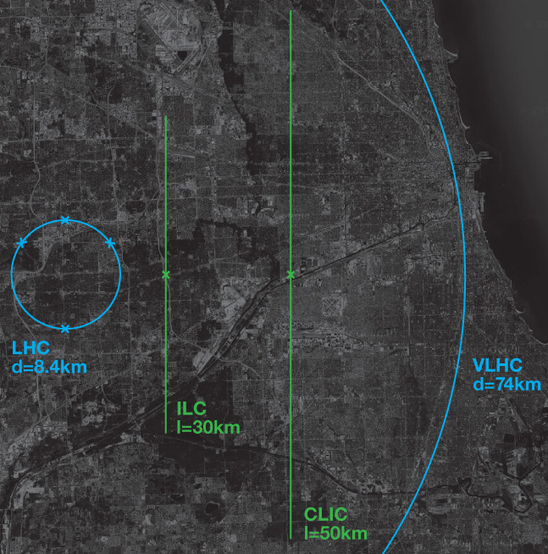
Motivation: Higgs Challenges
Want to study the Higgs boson
Discovered via protons
Requires large facility
Large Hadron Collider (LHC) is 8.4 km in diameter
Proposed accelerators only get bigger

Slide 11
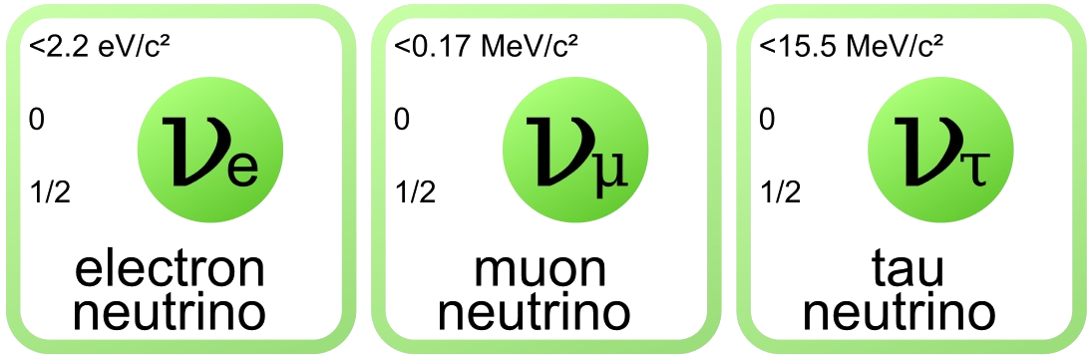
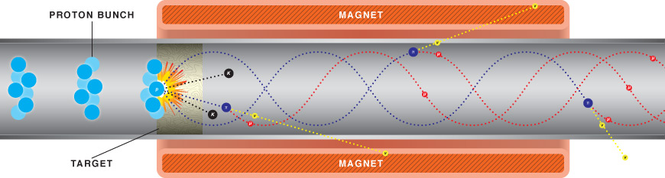
Motivation: Neutrino Challenges
Neutrinos can mix flavors
Need long experiment to allow flavor mixing
Neutrinos are neutral
Neutrinos prone to diverge
Neutrinos produced via decay

Slide 12
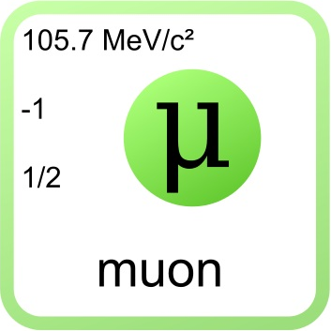
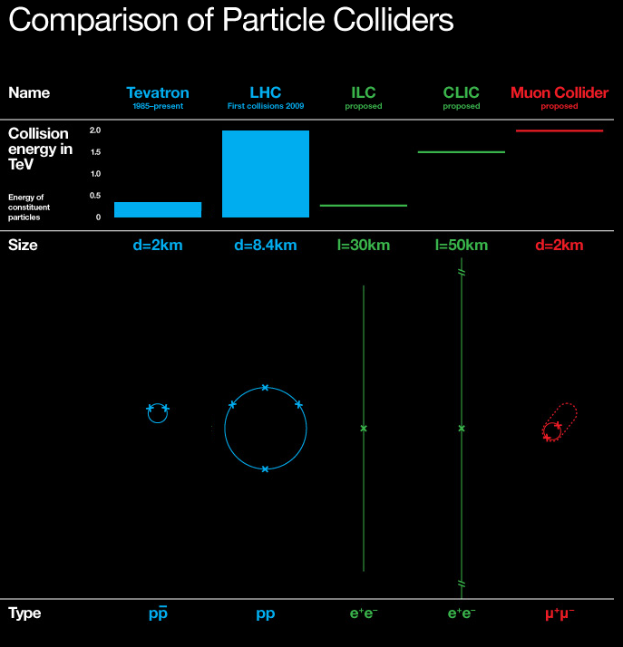
Motivation: Muon Facilities
Recap:
Higgs facilities are too large and costly
Neutrino facilities produce poor quality beam
Muon facilities solve both problems
Muons are fundamental (unlike protons), so small facility is possible
Muons decay to produce neutrinos, but can be focused first

Slide 13
Outline
Motivation
Fundamental particle physics
The Higgs Boson
Neutrinos
Muon facilities
Introduction to COSY Infinity
Transfer map methods
Transfer map example
Stochastic Processes
Ionization cooling
Why not use transfer maps?
Energy straggling
Multiple scattering
Transverse Displacement
Time-of-Flight
Results
Benchmarking
Validation
MICE
Summary

Slide 14
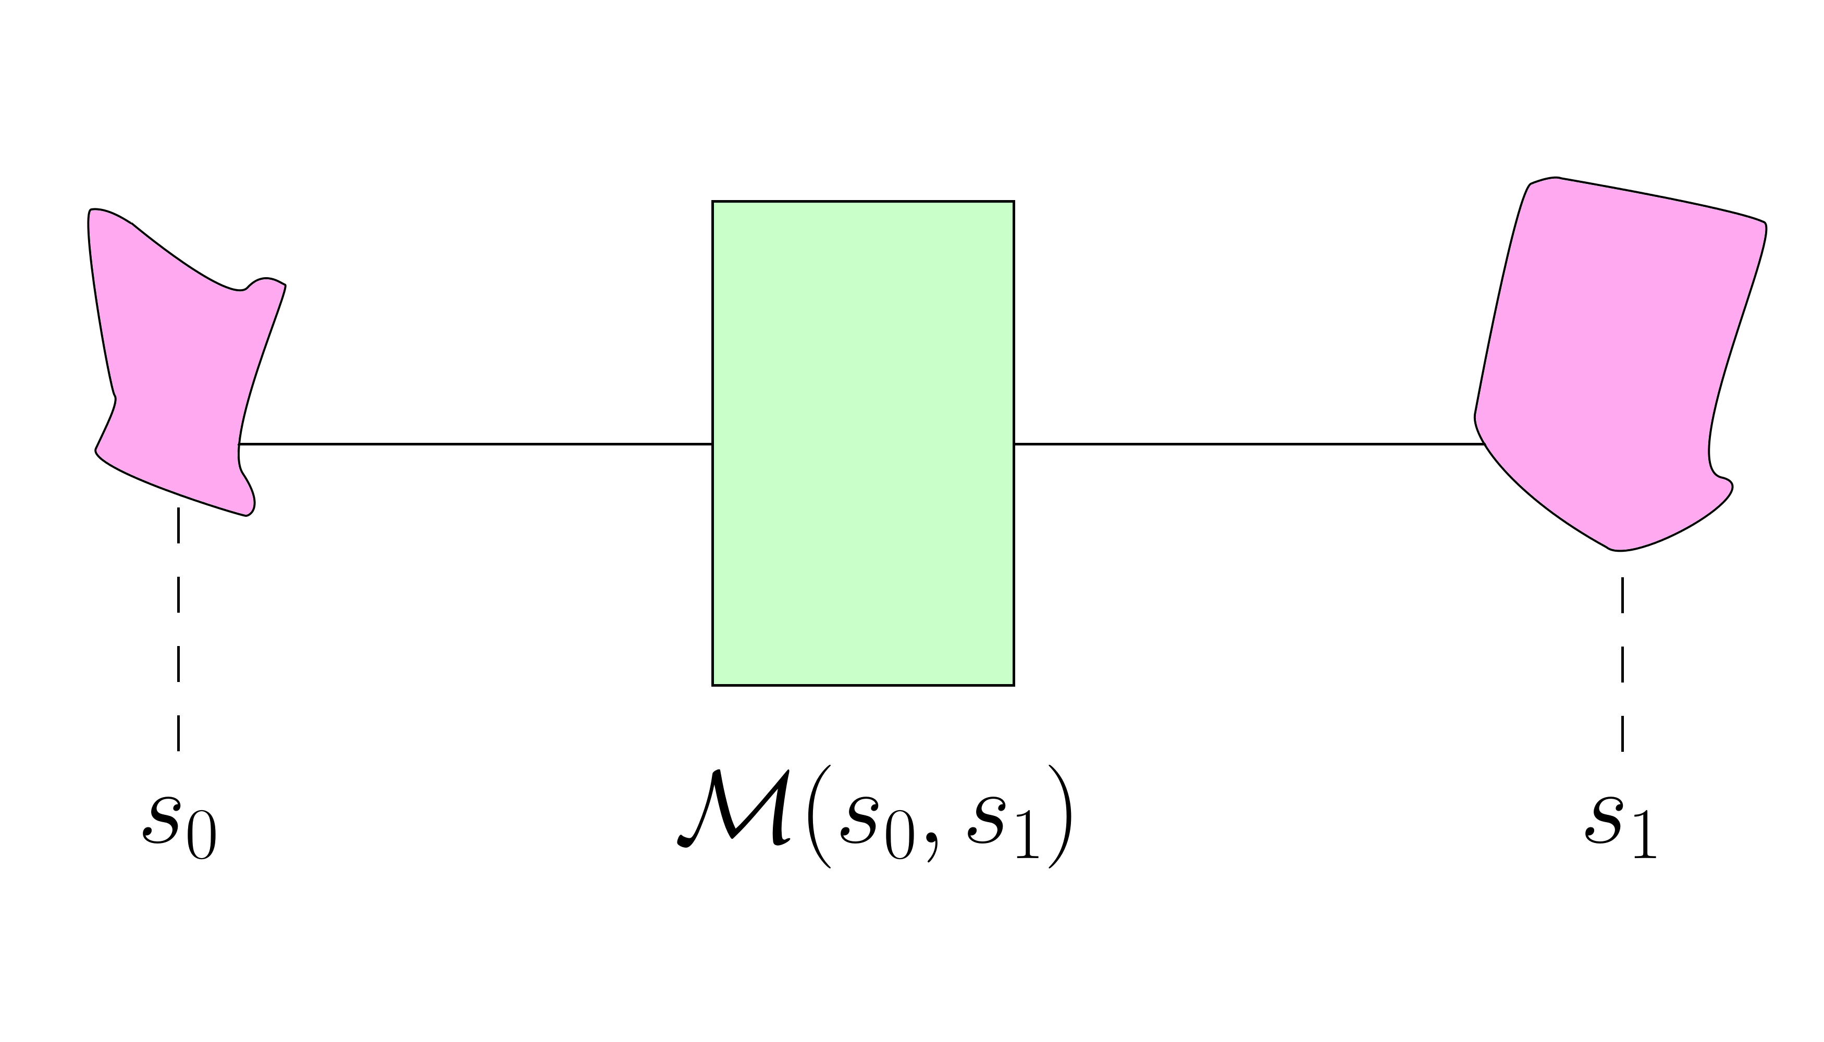
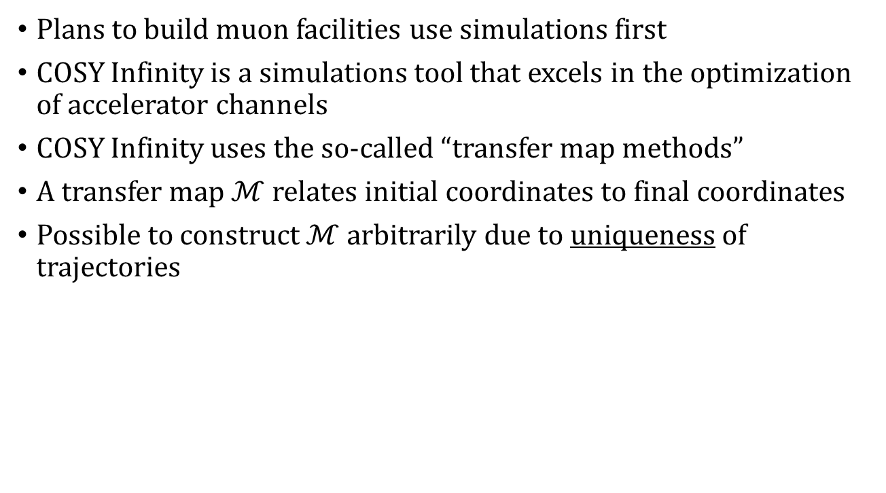
Introduction: Transfer Map Methods
Plans to build muon facilities use simulations first
COSY Infinity is a simulations tool that excels in the optimization of accelerator channels
COSY Infinity uses the so-called “transfer map methods”
A transfer map $ℳ$ relates initial coordinates to final coordinates
Possible to construct $ℳ$ arbitrarily due to uniqueness of trajectories

Slide 15
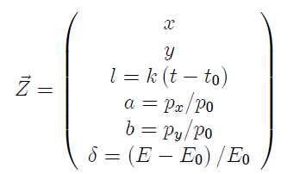
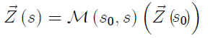
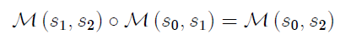
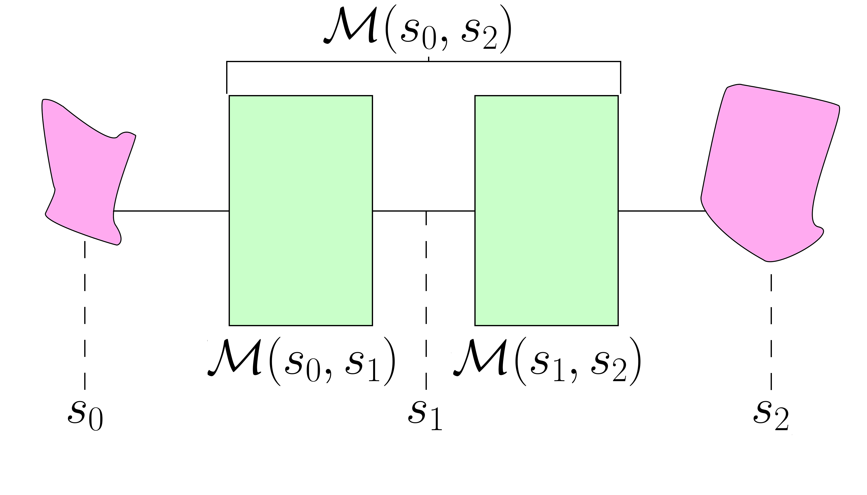
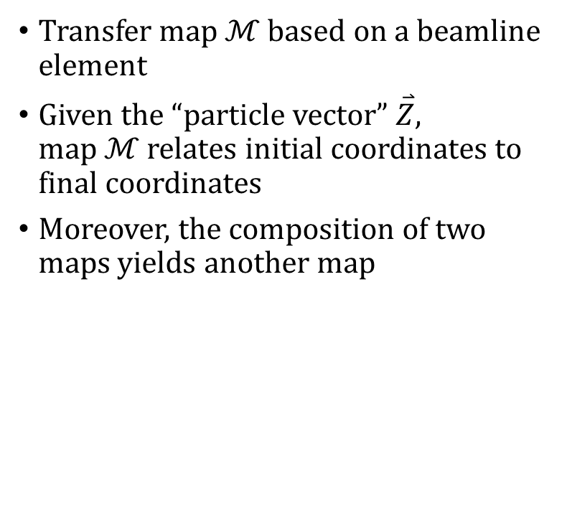
Introduction: Transfer Map Methods
Transfer map $ℳ$ based on a beamline element
Given the “particle vector” $\overset{⃑}{Z}$, map $ℳ$ relates initial coordinates to final coordinates
Moreover, the composition of two maps yields another map

Slide 16
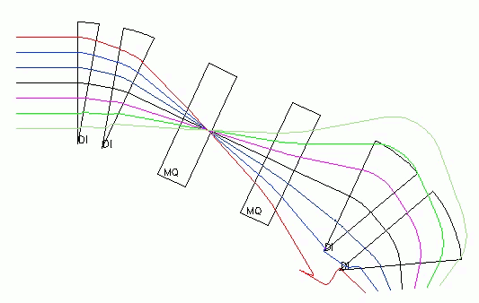
Introduction: Transfer Map Example

Slide 17
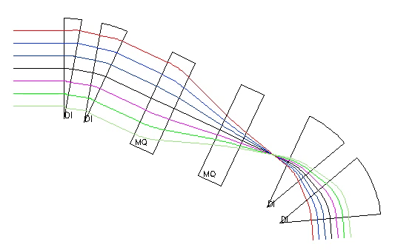
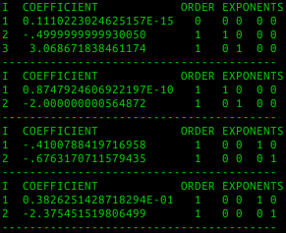
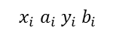
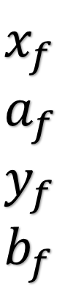
Introduction: Transfer Map Example
$$x_{i} a_{i} y_{i} b_{i}$$
$$x_{f} \\ a_{f} \\ y_{f} \\ b_{f}$$

Slide 18
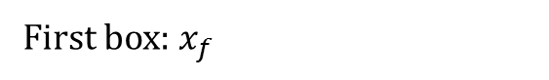
Introduction: Transfer Map Example
$$x_{i} a_{i} y_{i} b_{i}$$
$$x_{f} \\ a_{f} \\ y_{f} \\ b_{f}$$
First box: $x_{f}$

Slide 19
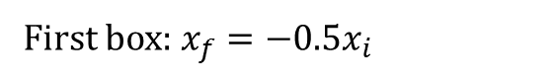
Introduction: Transfer Map Example
$$x_{i} a_{i} y_{i} b_{i}$$
$$x_{f} \\ a_{f} \\ y_{f} \\ b_{f}$$
First box: $x_{f}=−0.5x_{i}$

Slide 20
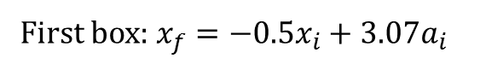
Introduction: Transfer Map Example
$$x_{i} a_{i} y_{i} b_{i}$$
$$x_{f} \\ a_{f} \\ y_{f} \\ b_{f}$$
First box: $x_{f}=−0.5x_{i}+3.07a_{i}$

Slide 21
Introduction: Transfer Map Example
$$x_{i} a_{i} y_{i} b_{i}$$
$$x_{f} \\ a_{f} \\ y_{f} \\ b_{f}$$
0
First box: $x_{f}=−0.5x_{i}+3.07a_{i}$

Slide 22
Introduction
Want to use COSY transfer map approach to study muon facilities
Fast!
Particles can be simulated through many meters via single map
Matrix multiplication instead of propagation

Slide 23
Outline
Motivation
Fundamental particle physics
The Higgs Boson
Neutrinos
Muon facilities
Introduction to COSY Infinity
Transfer map methods
Transfer map example
Stochastic Processes
Ionization cooling
Why not use transfer maps?
Energy straggling
Multiple scattering
Transverse Displacement
Time-of-Flight
Results
Benchmarking
Validation
MICE
Summary

Slide 24
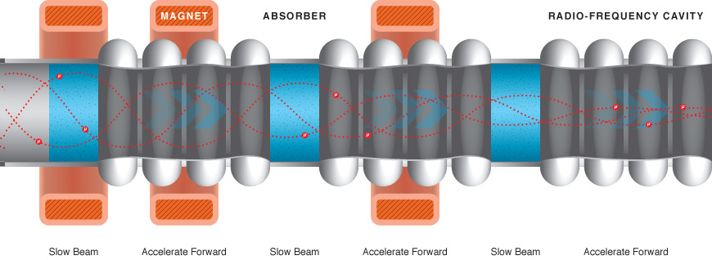
Stochastic Processes: Ionization Cooling
Recall: muons decay
Best method of collecting, focusing, and accelerating muons is “ionization cooling”
“Absorber” – low-Z material (e.g. liquid hydrogen)
Beam ionizes the material; beam loses momentum
Radiofrequency cavity restores longitudinal momentum
Result: reduced transverse momentum

Slide 25
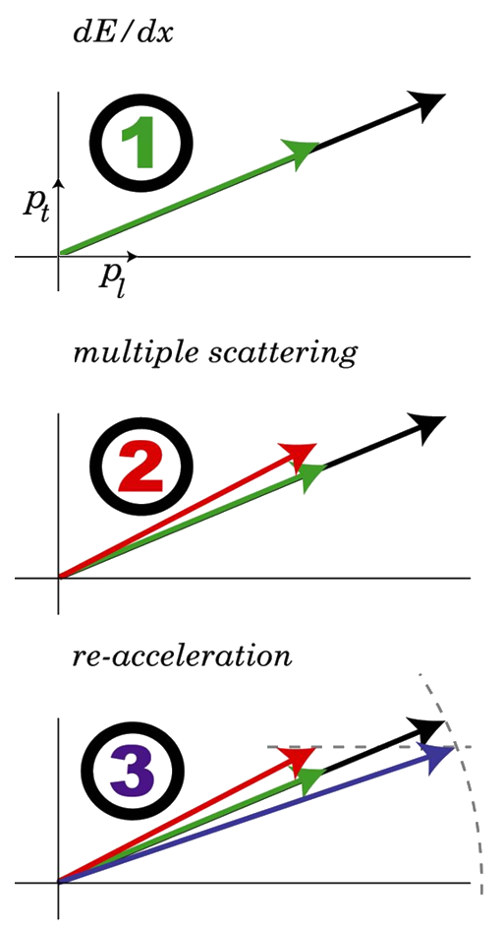
Stochastic Processes: Ionization Cooling
dE/dx Beam loses momentum, both transverse and longitudinal.
Multiple scattering Transverse momentum grows due to scattering effects.
Re-acceleration Longitudinal momentum increased via RF cavity. Total momentum remains the same. Transverse momentum reduced.

Slide 26
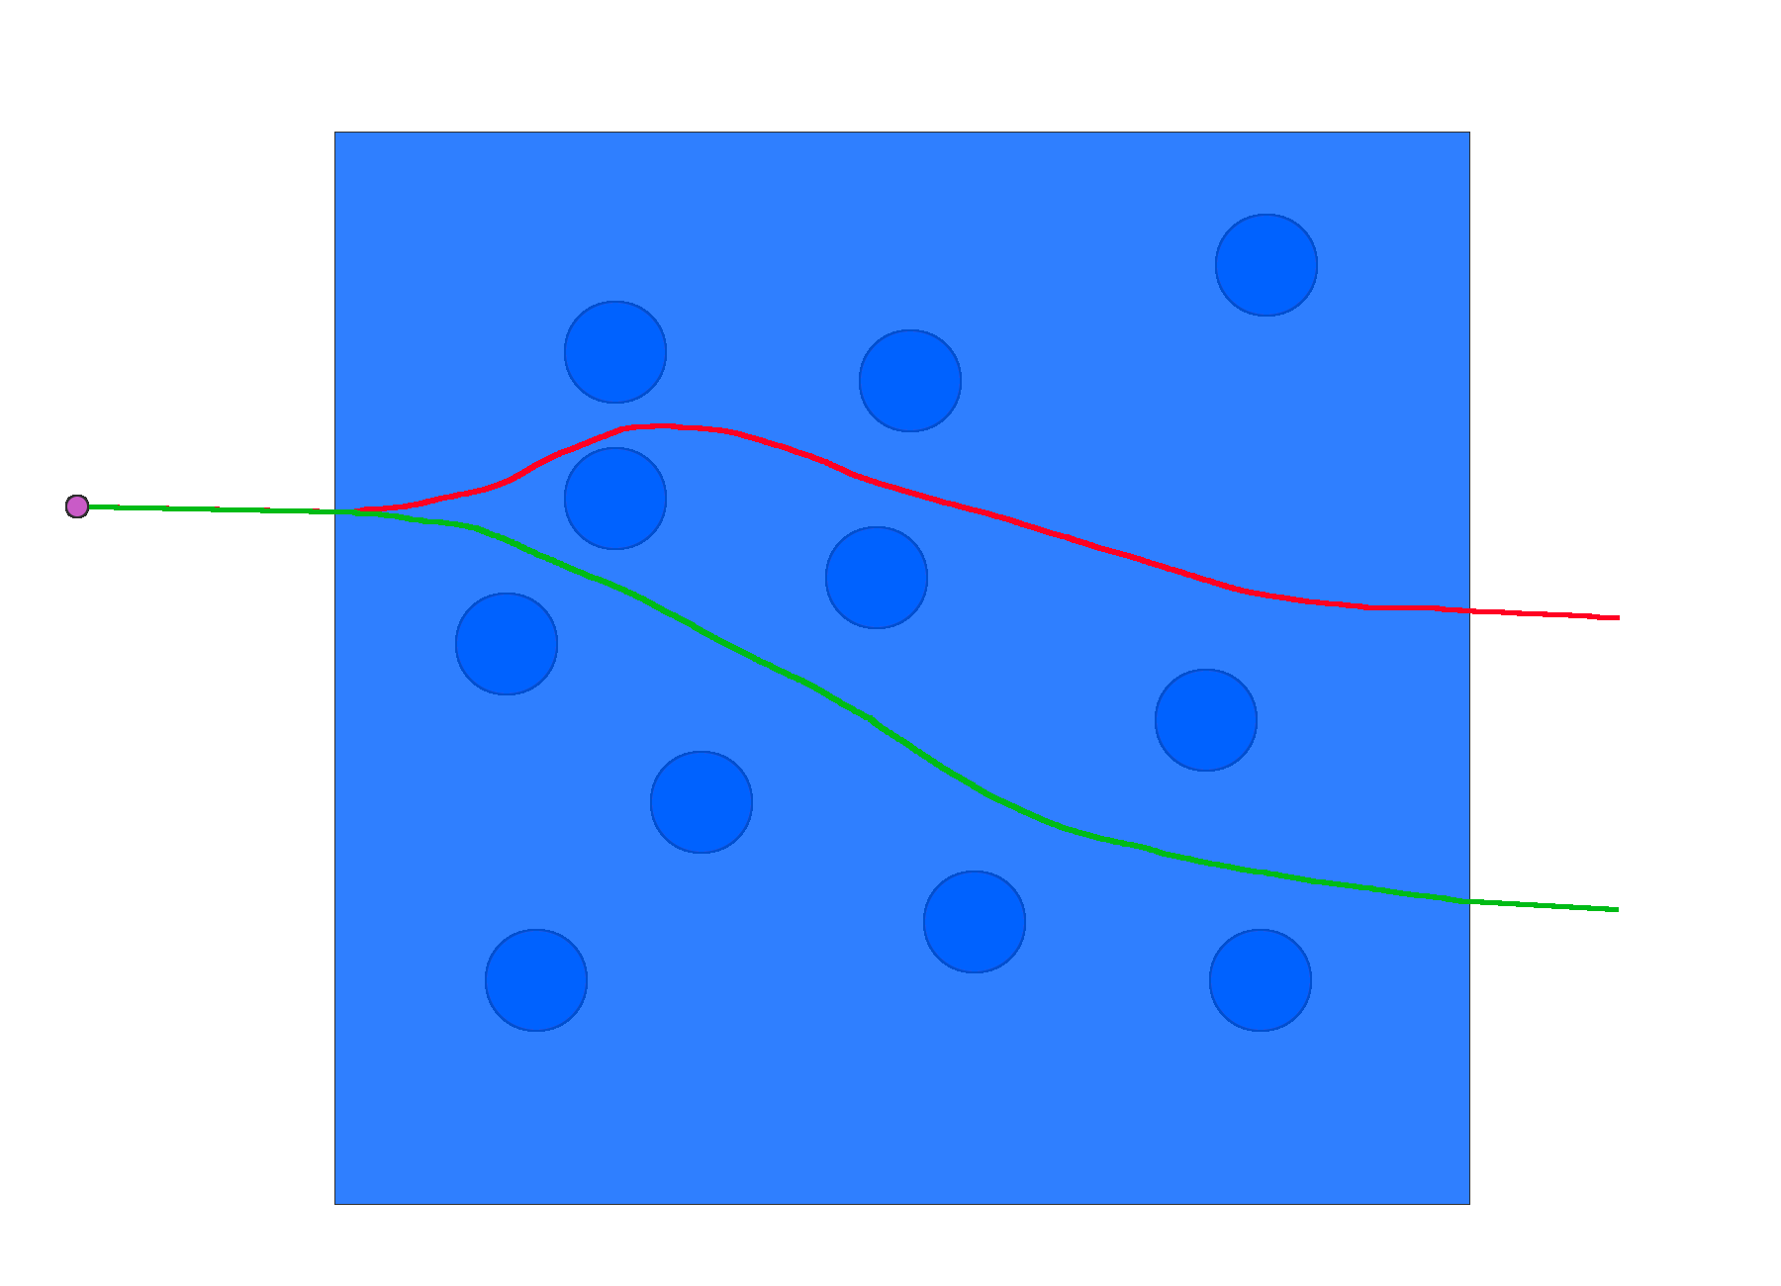
Stochastic Processes: Why not use maps?
It is only possible to construct a transfer map if the particle has a unique evolution
This is not true due to energy straggling, multiple scattering
Quantum effects → intrinsically random
Stochastic processes do not fit into the transfer map paradigm

Slide 27
Goal
Outfit COSY Infinity with tools to handle stochastic processes
Should be particle-by-particle propagation, not transfer maps

Slide 28
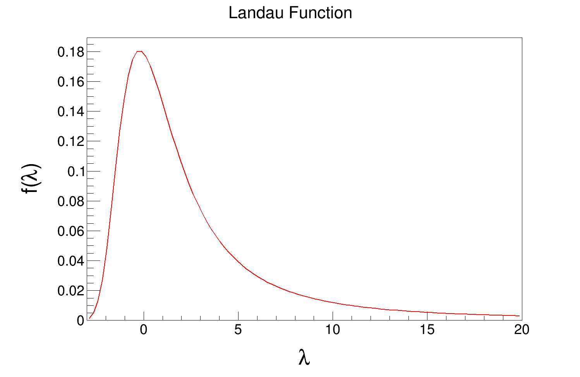
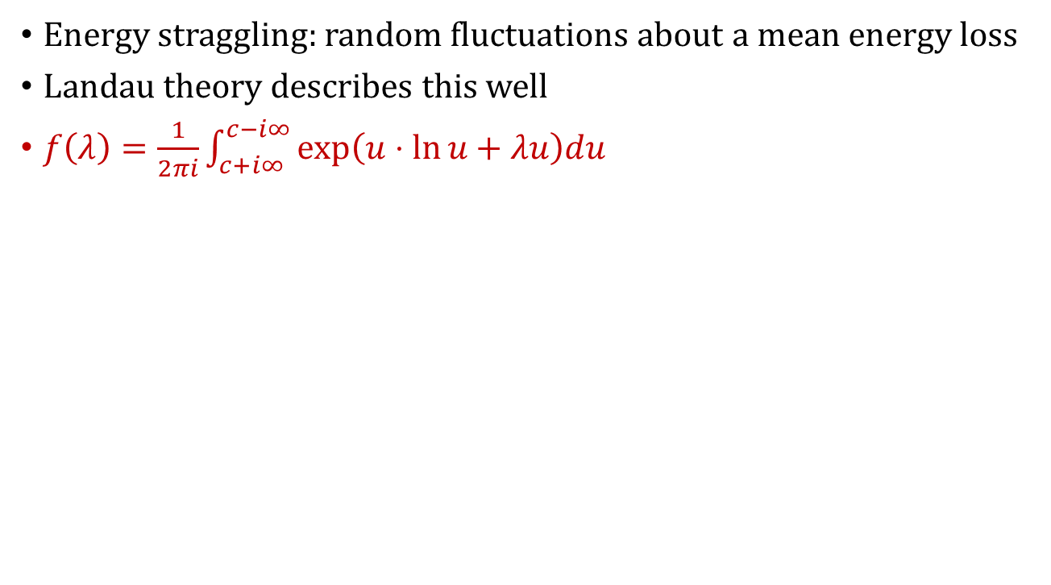
Stochastic Processes: Energy Straggling
Energy straggling: random fluctuations about a mean energy loss
Landau theory describes this well
$f\left(λ\right)=\frac{1}{2πi}\int_{c+i∞}^{c−i∞}{exp\left(u⋅\ln{u+λu}\right)du}$

Slide 29
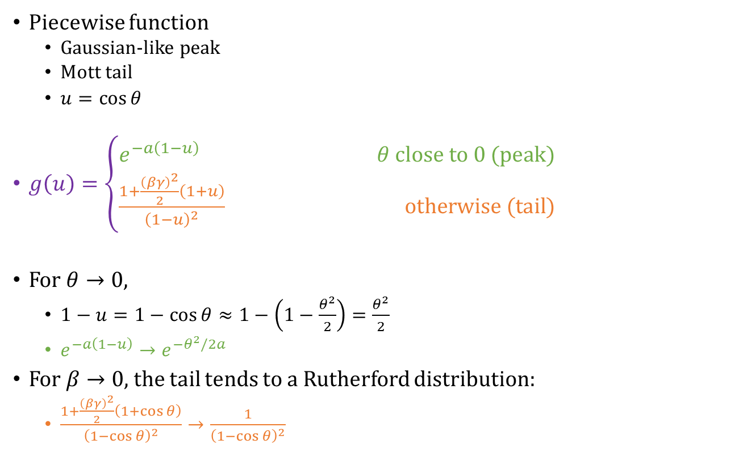
Stochastic Processes: Multiple Scattering
Piecewise function
Gaussian-like peak
Mott tail
$u=\cos{θ}$
$g\left(u\right)=\left\{\begin{aligned}e^{−a\left(1−u\right)} θ close to 0 (peak) \\ \frac{1+\frac{{\left(βγ\right)}^{2}}{2}\left(1+u\right)}{{\left(1−u\right)}^{2}} otherwise (tail)\end{aligned}\right.$
For $θ→0$,
$1−u=1−\cos{θ}≈1−\left(1−\frac{θ^{2}}{2}\right)=\frac{θ^{2}}{2}$
$e^{−a\left(1−u\right)}→e^{−θ^{2}/2a}$
For $β→0$, the tail tends to a Rutherford distribution:
$\frac{1+\frac{{\left(βγ\right)}^{2}}{2}\left(1+\cos{θ}\right)}{{\left(1−\cos{θ}\right)}^{2}}→\frac{1}{{\left(1−\cos{θ}\right)}^{2}}$

Slide 30
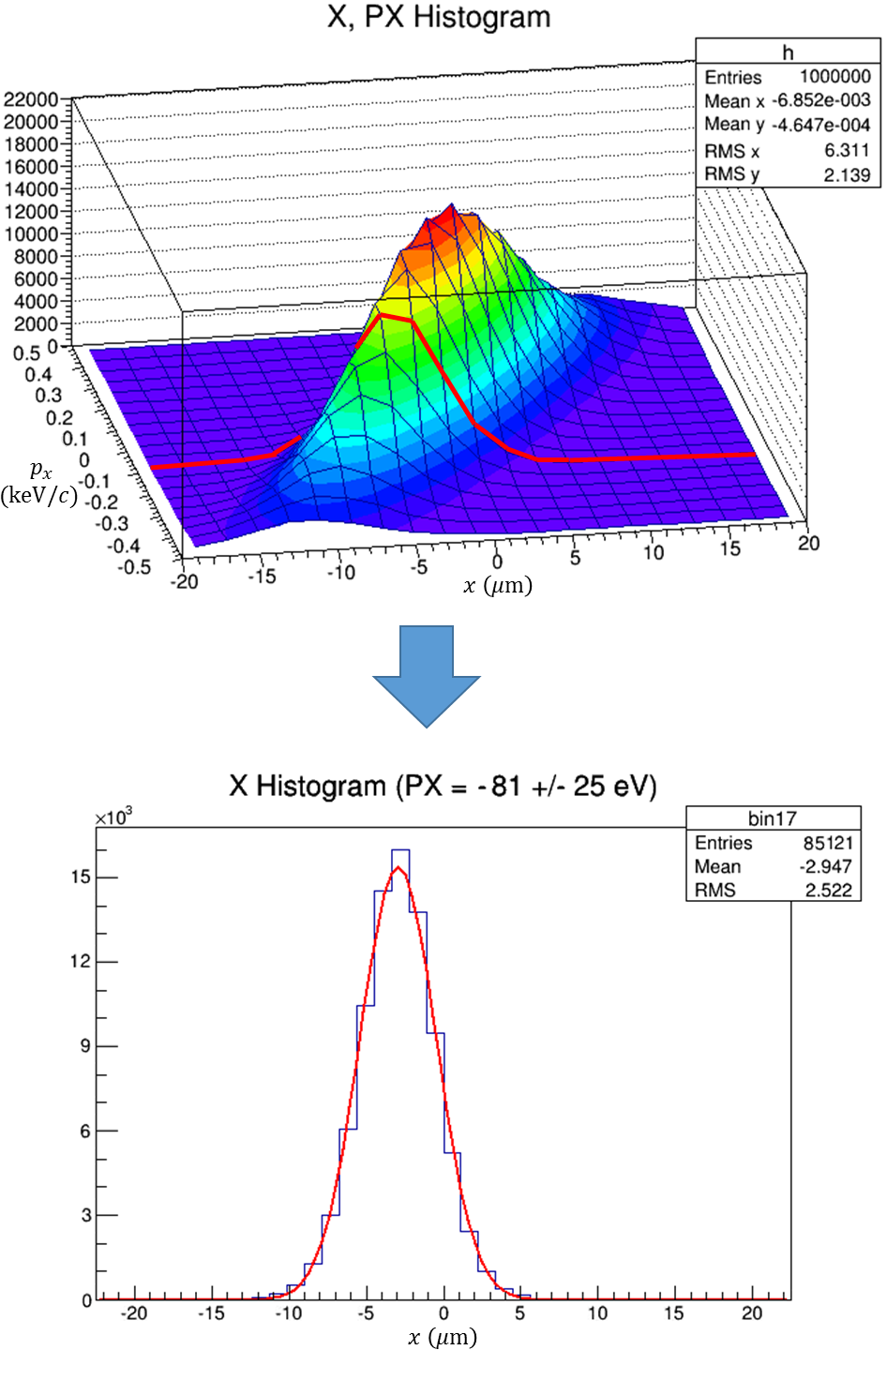
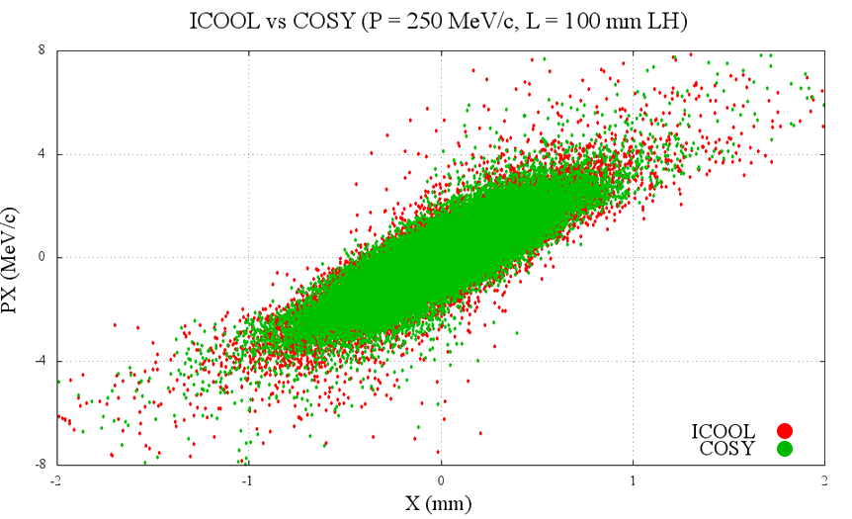
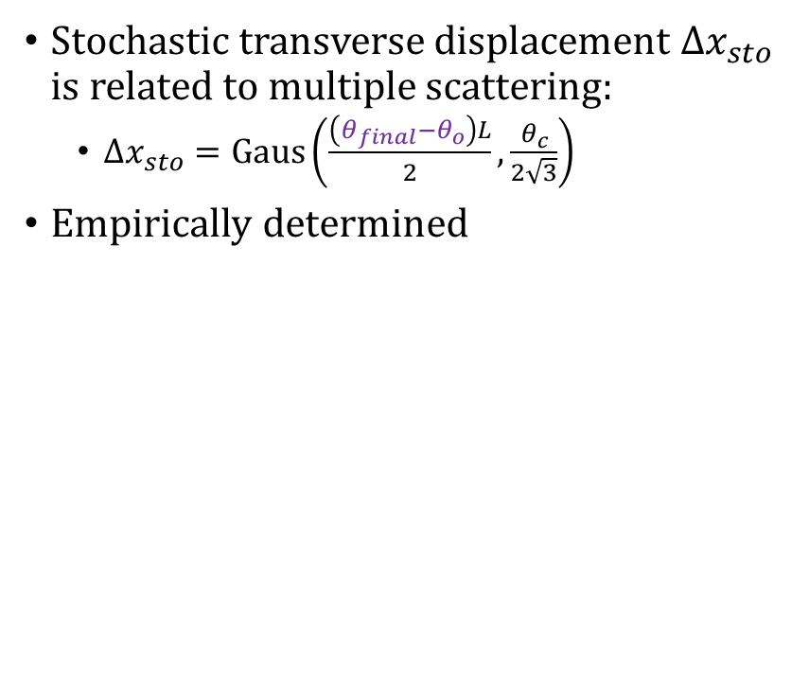
Stochastic Processes: Transverse Displacement
Stochastic transverse displacement $Δx_{sto}$ is related to multiple scattering:
$Δx_{sto}=Gaus\left(\frac{\left(θ_{final}−θ_{o}\right)L}{2},\frac{θ_{c}}{2\sqrt{3}}\right)$
Empirically determined

Slide 31
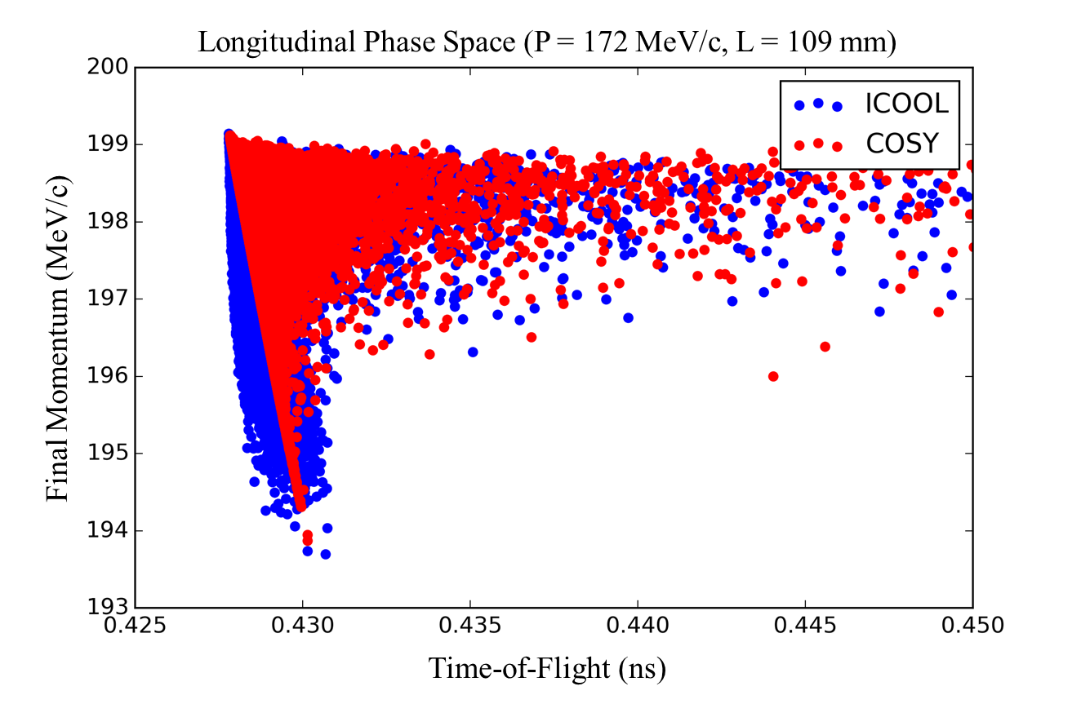
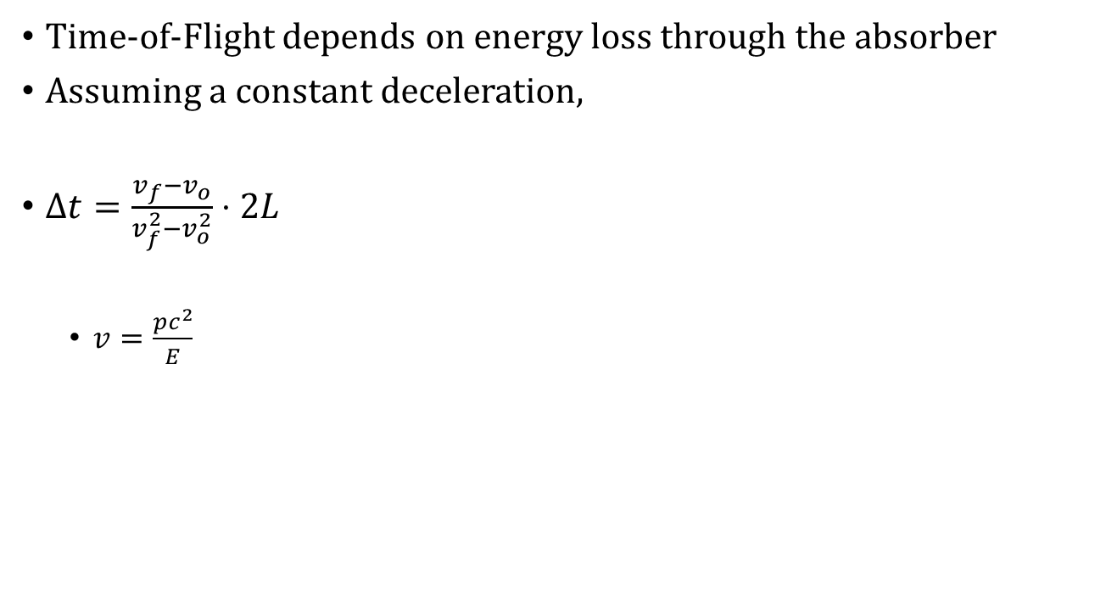
Stochastic Processes: Time-of-Flight
Time-of-Flight depends on energy loss through the absorber
Assuming a constant deceleration,
$Δt=\frac{v_{f}−v_{o}}{v_{f}^{2}−v_{o}^{2}}⋅2L$
$v=\frac{pc^{2}}{E}$

Slide 32
Outline
Motivation
Fundamental particle physics
The Higgs Boson
Neutrinos
Muon facilities
Introduction to COSY Infinity
Transfer map methods
Transfer map example
Stochastic Processes
Ionization cooling
Why not use transfer maps?
Energy straggling
Multiple scattering
Transverse Displacement
Time-of-Flight
Results
Benchmarking
Validation
MICE
Summary

Slide 33
Results: Benchmarking
Benchmarking: testing new software against known codes
Needed because little experimental data exists
All stochastic processes have been empirically altered to give reasonable agreement with two other codes, ICOOL and G4Beamline
36 benchmarking figures seen in thesis (12 figures with 3 sub-figures each)

Slide 34
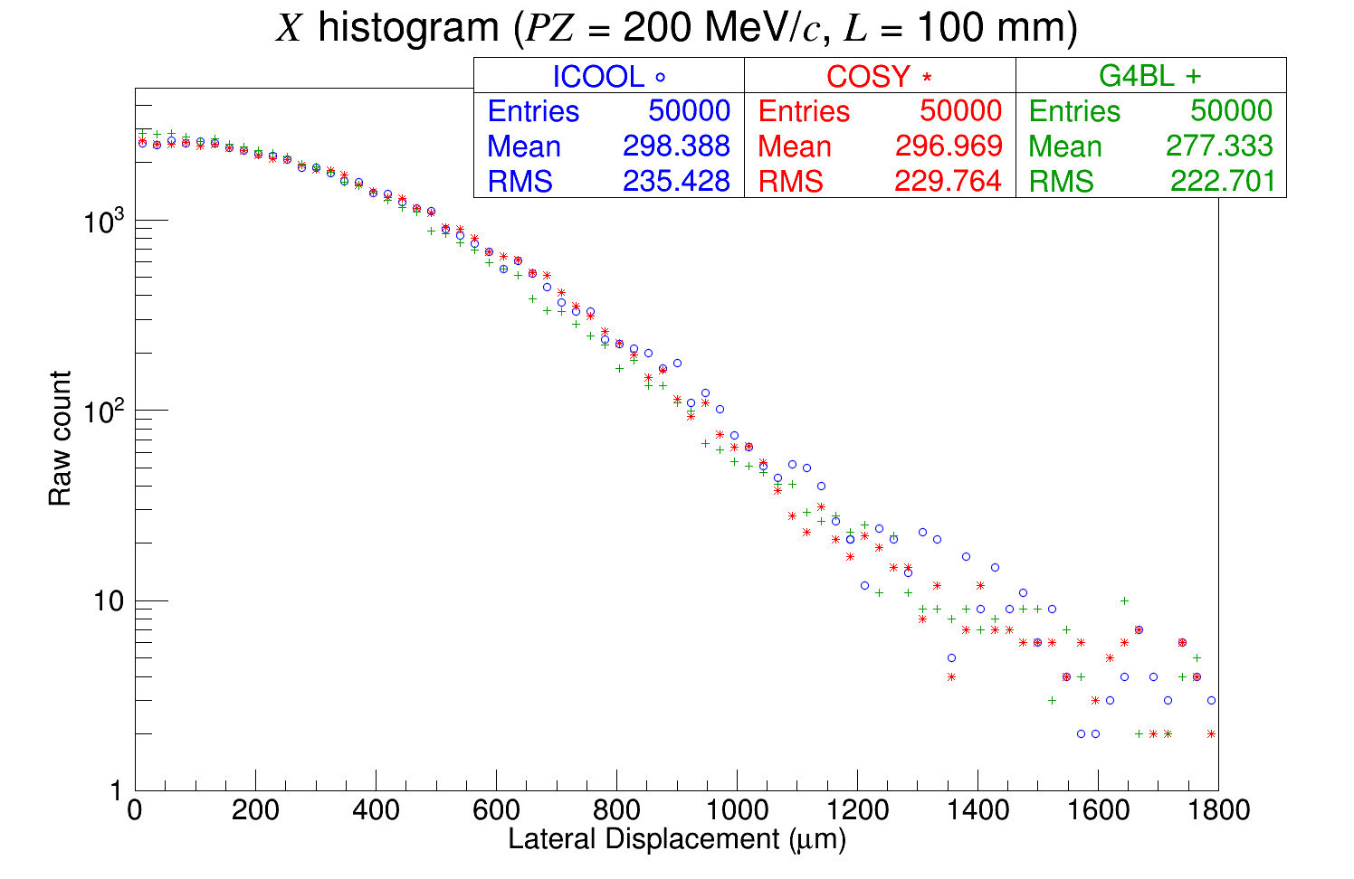
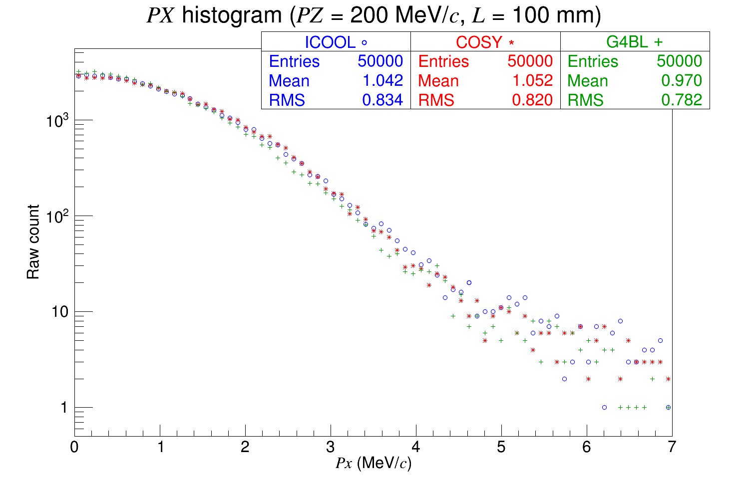
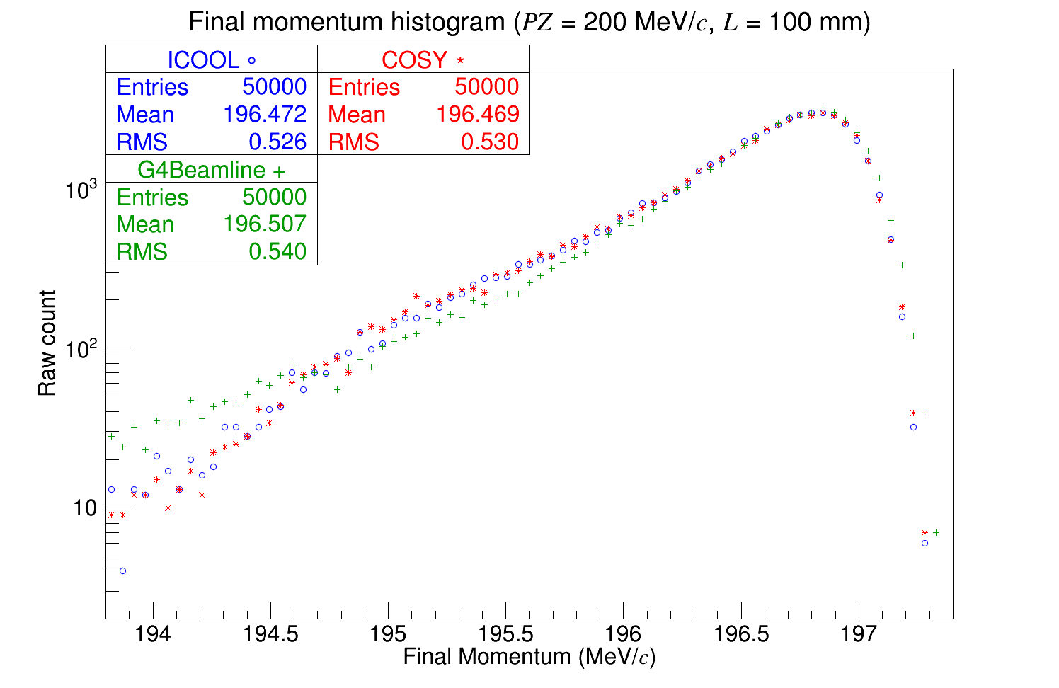
Pencil beam of 50k muons at 200 MeV/c through 100 mm of liquid hydrogen

Slide 35
Results: Validation
Validation: testing new software against experimental results
Stochastic processes were further altered to give agreement with experimental results from MuScat

Slide 36
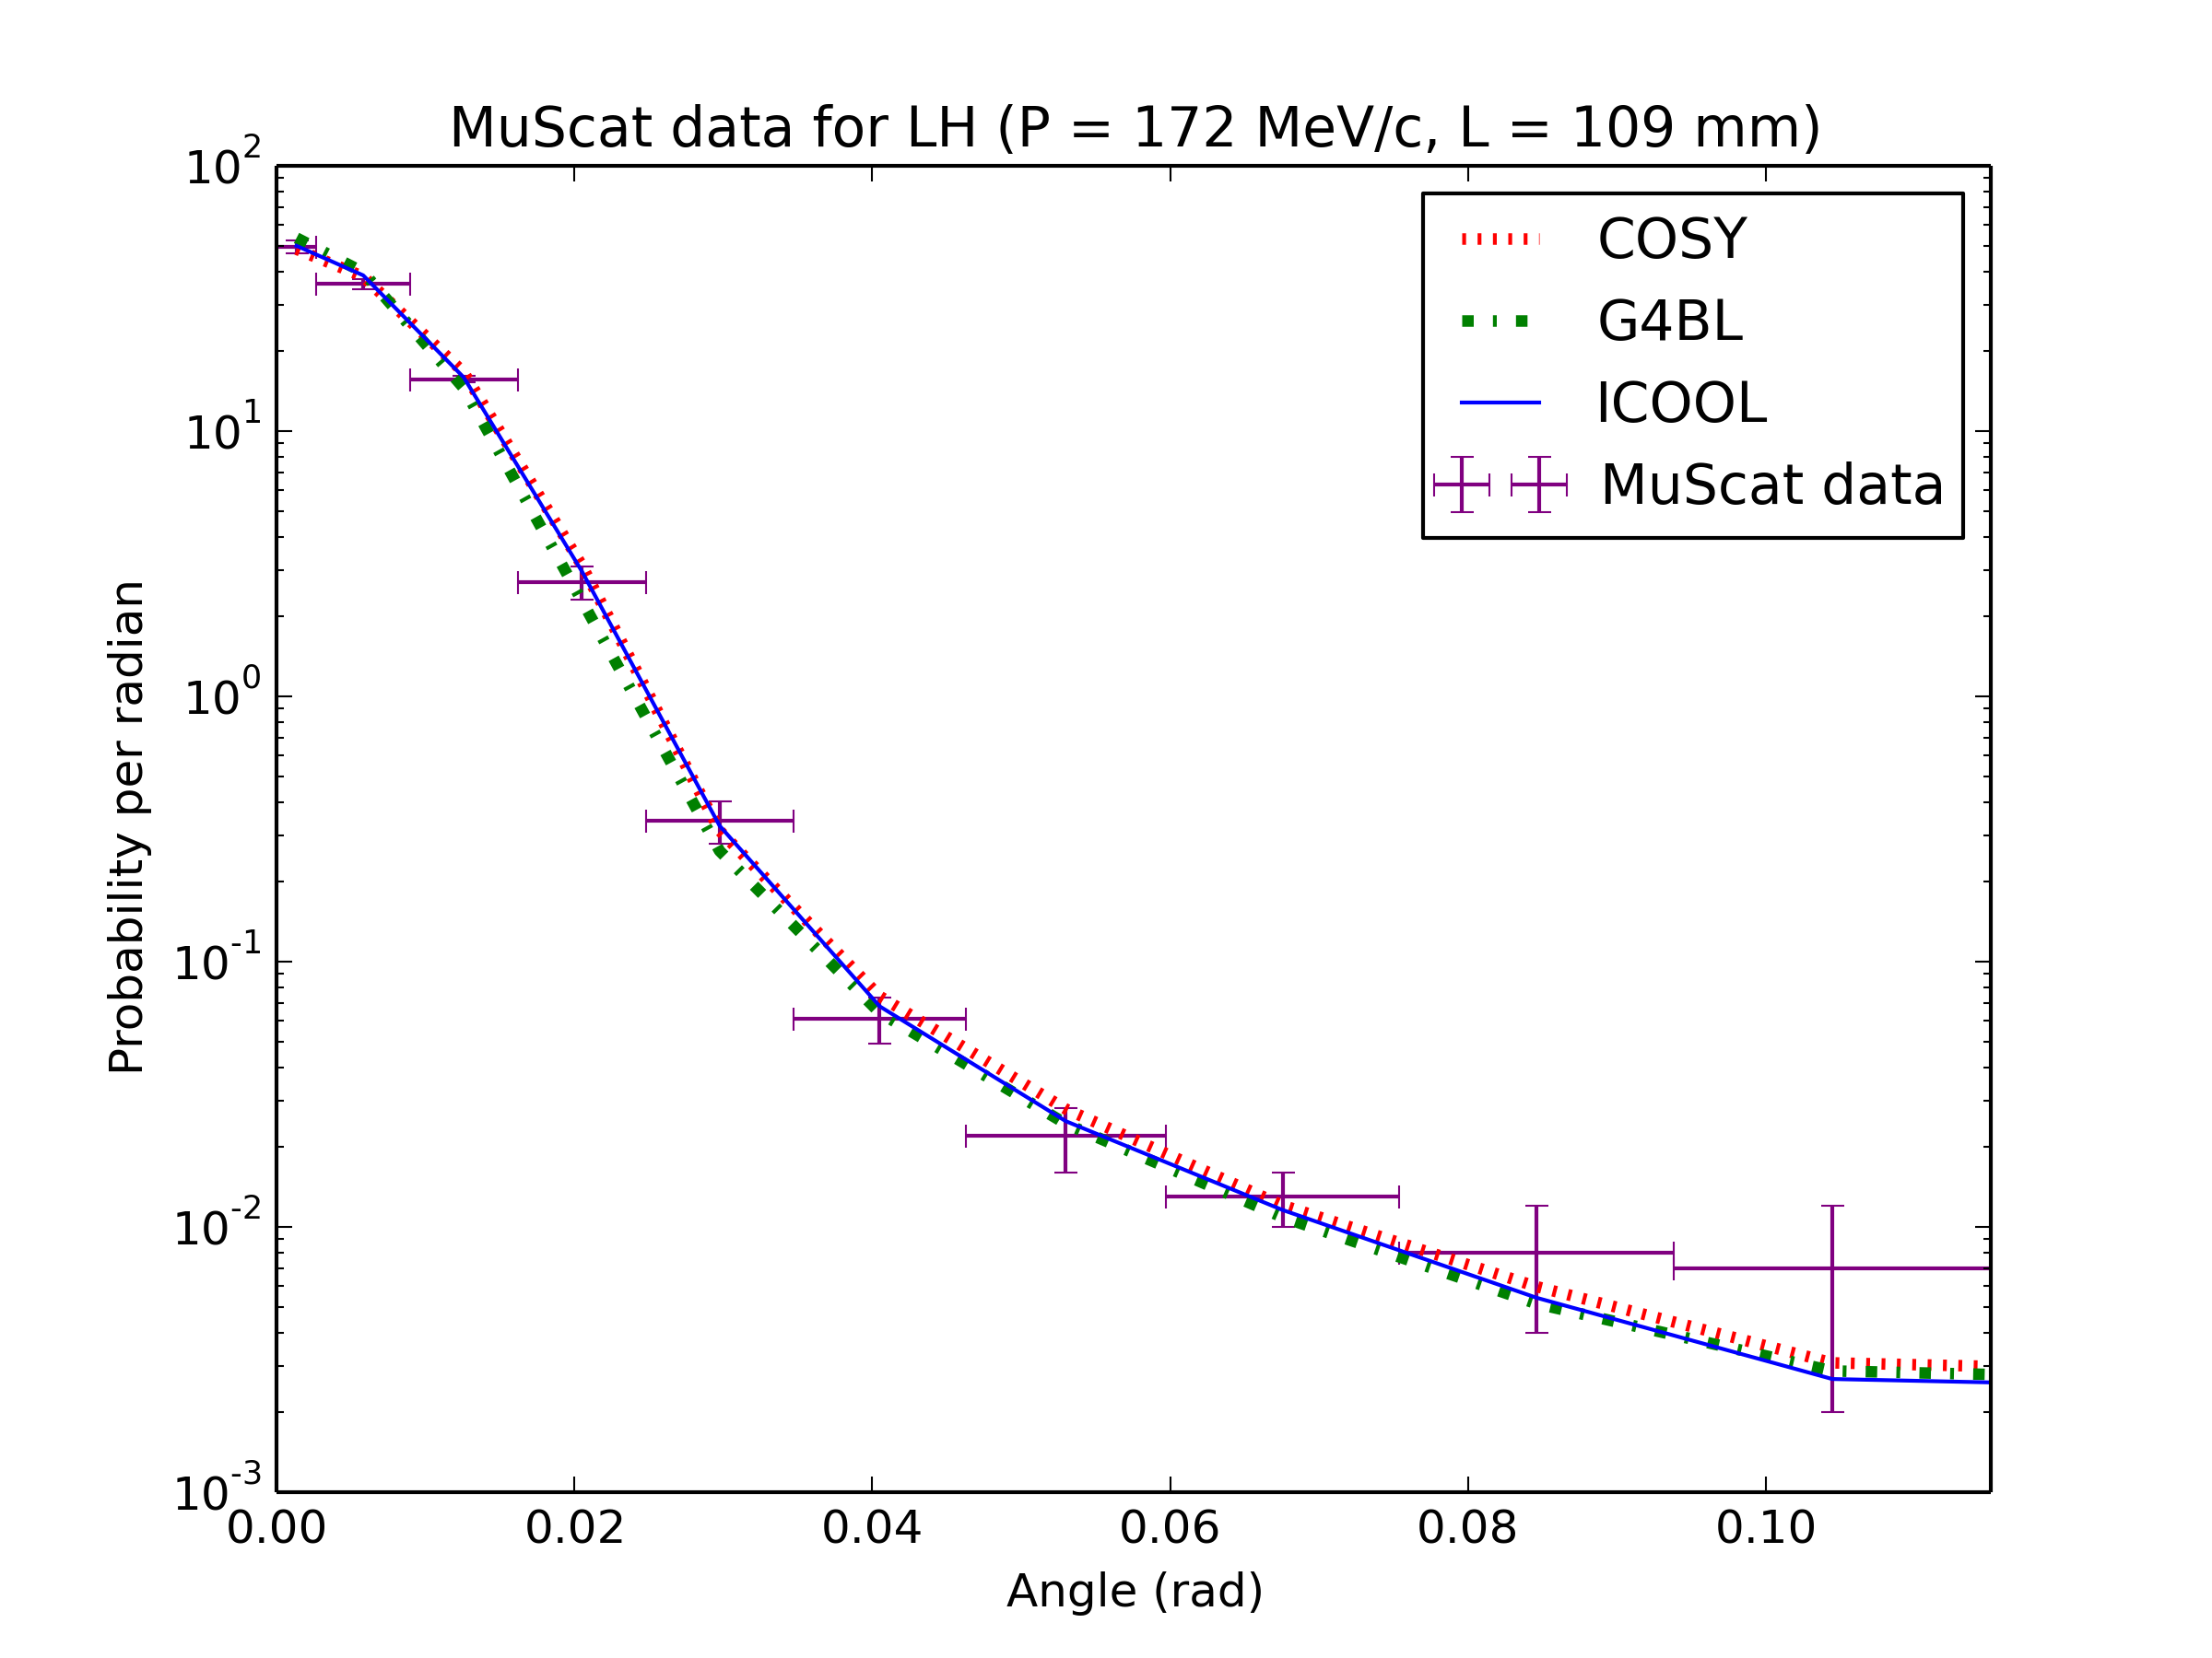
Results: Validation

Slide 37
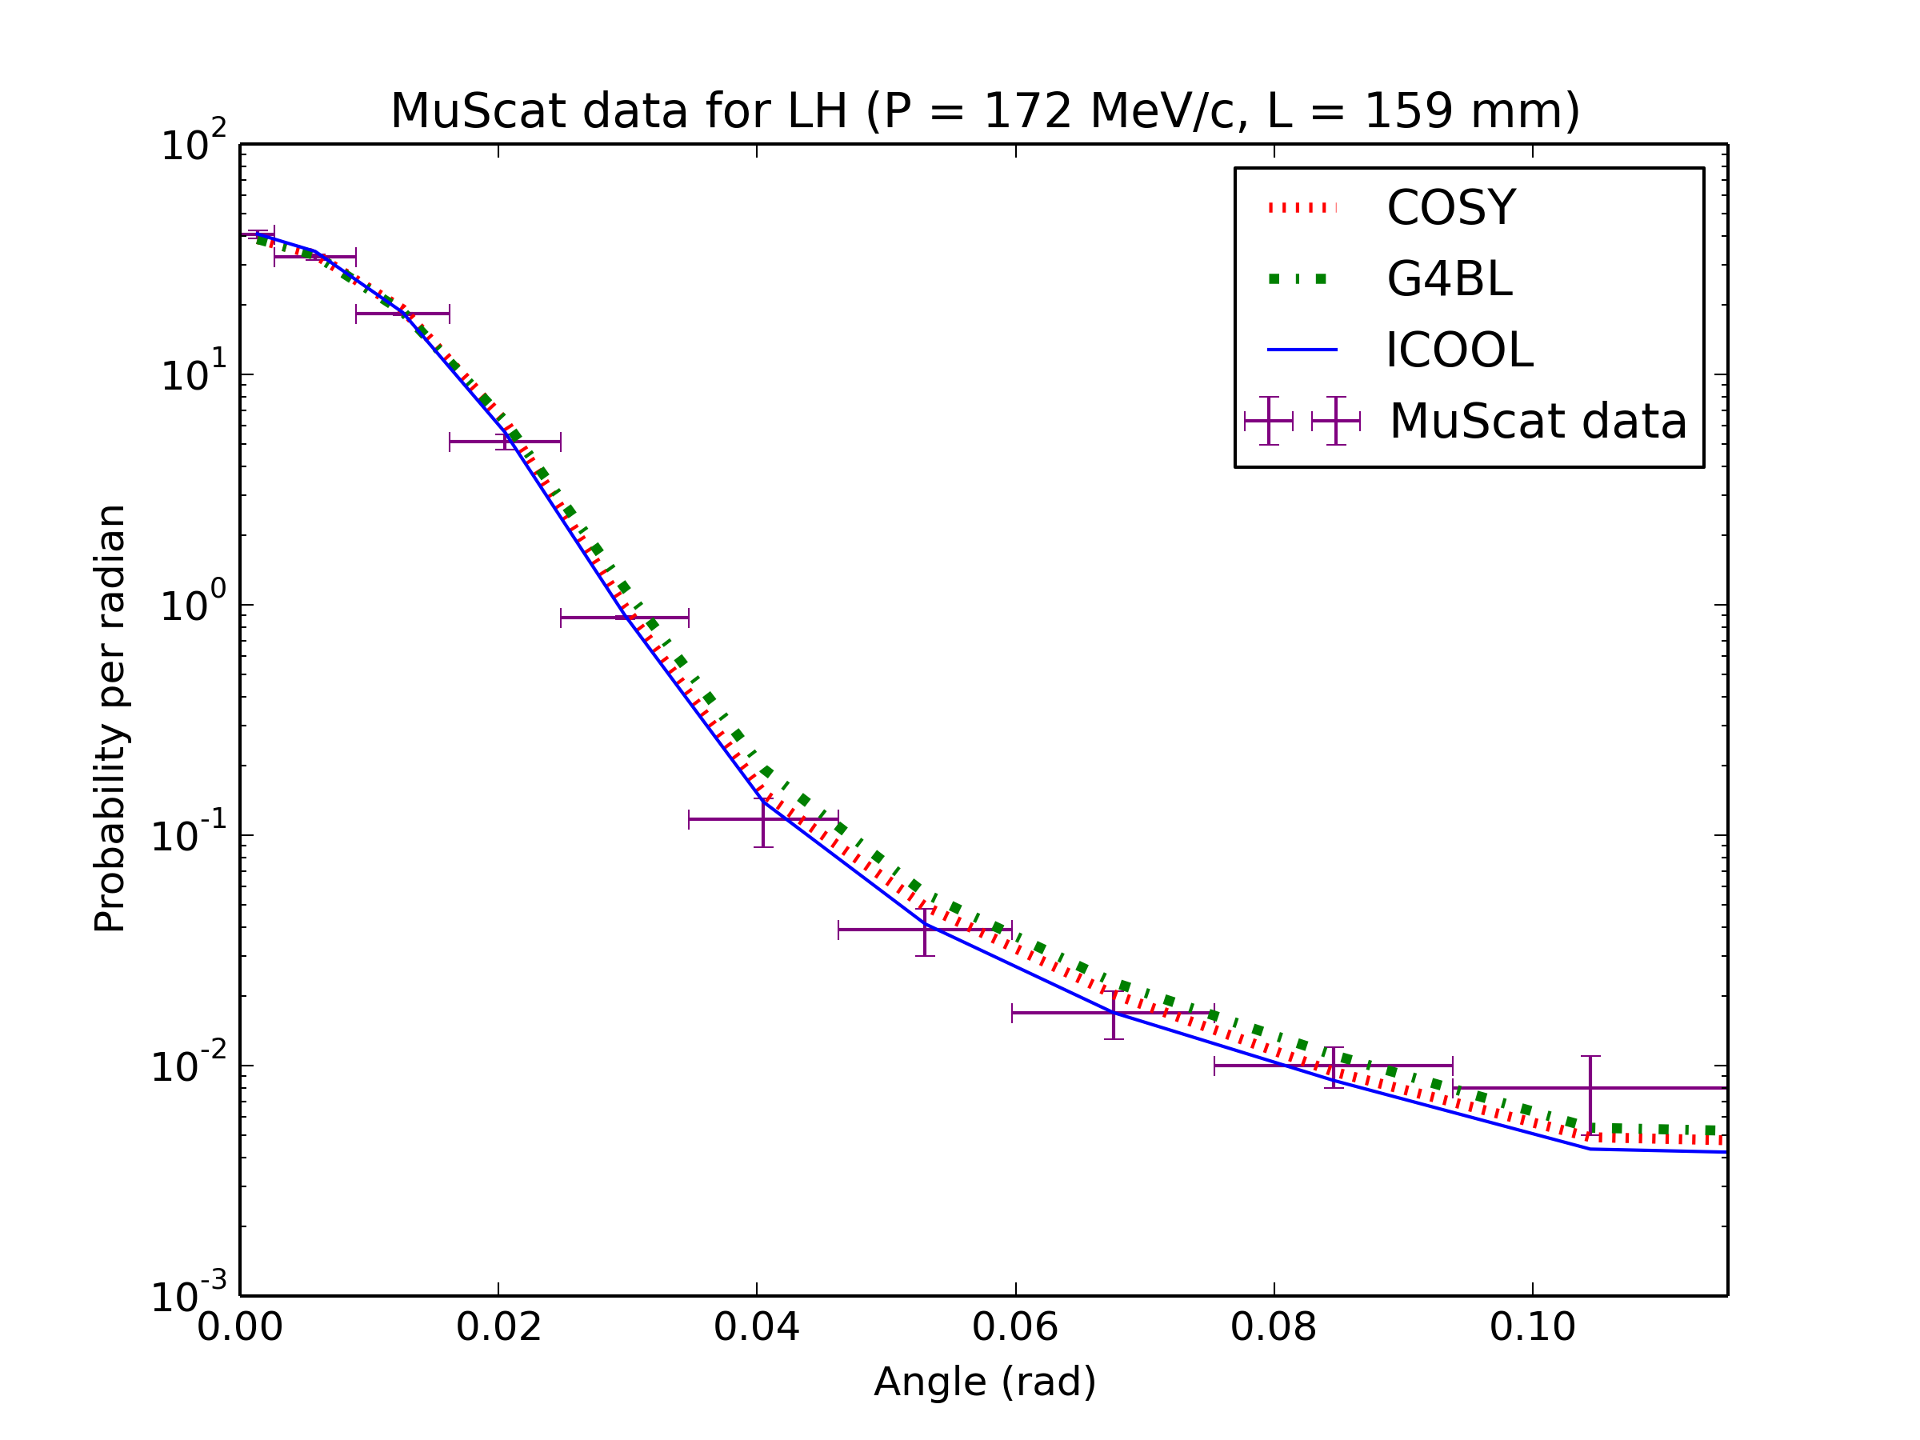
Results: Validation

Slide 38
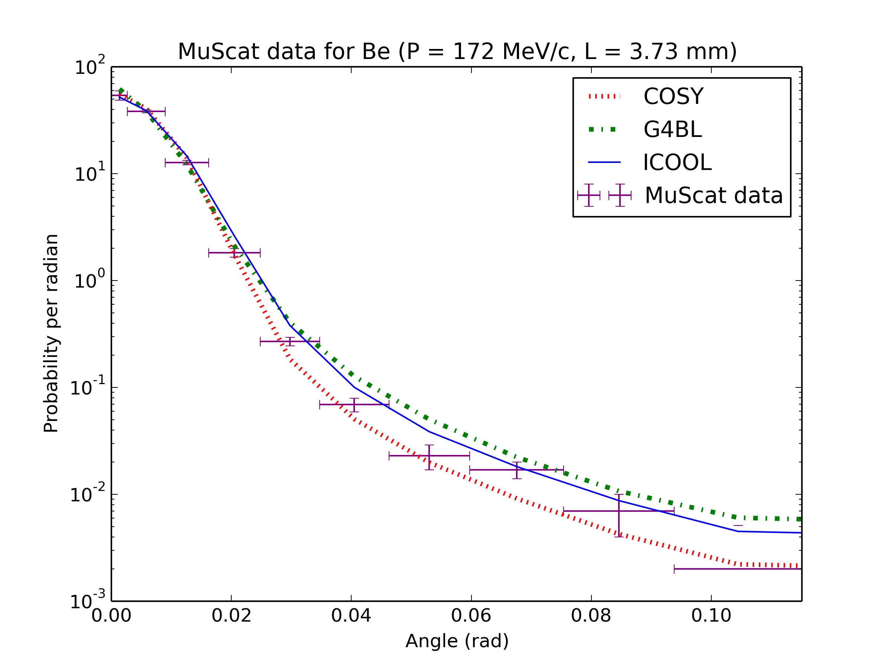
Results: Validation

Slide 39
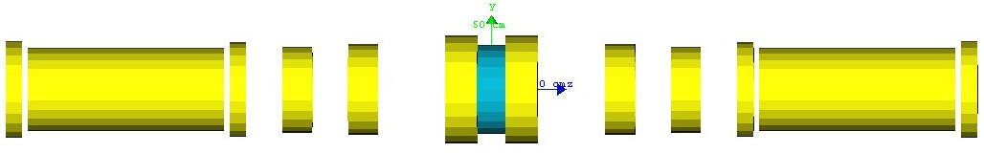
Results: MICE
The Muon Ionization Cooling Experiment (MICE) is an experiment being developed at Rutherford Appleton Laboratory in Oxfordshire, U.K.
Goal: a proof-of-principle demonstration of muon ionization cooling
MICE Step IV: 12 coils symmetric about an absorber

Slide 40
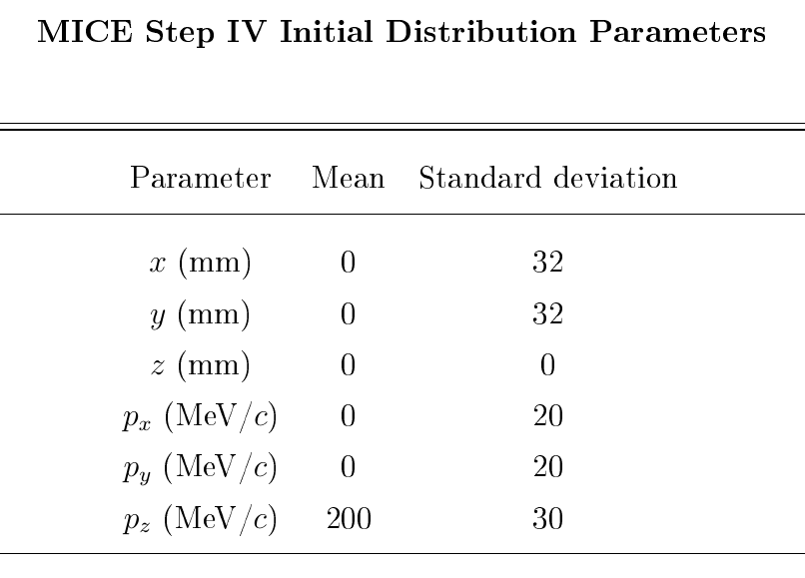
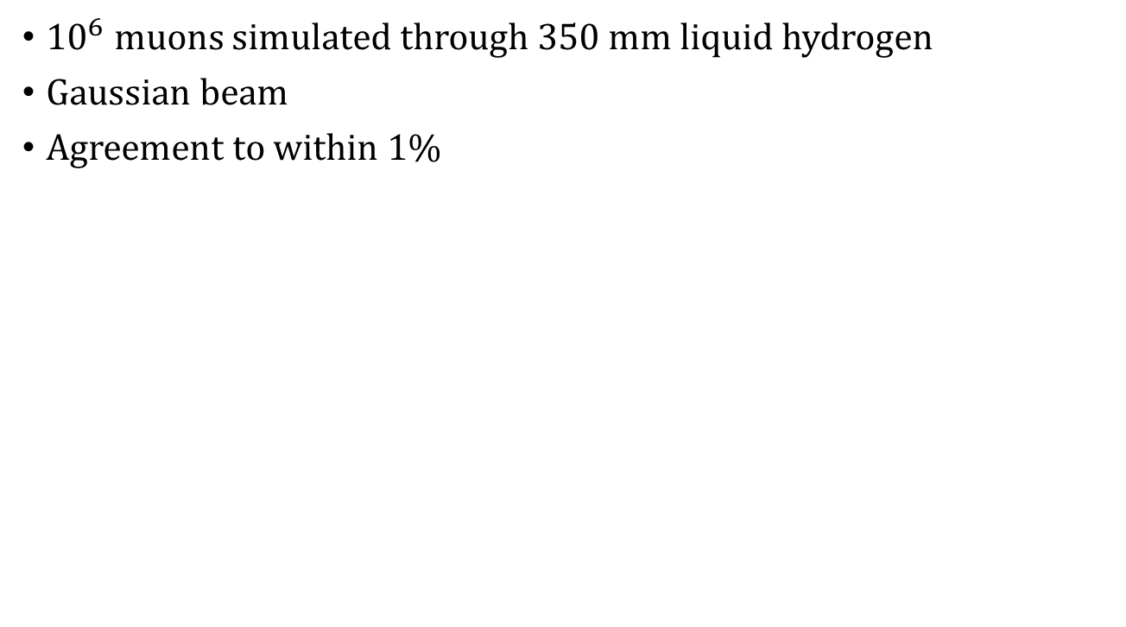
Results: MICE
${10}^{6}$ muons simulated through 350 mm liquid hydrogen
Gaussian beam
Agreement to within 1%

Slide 41
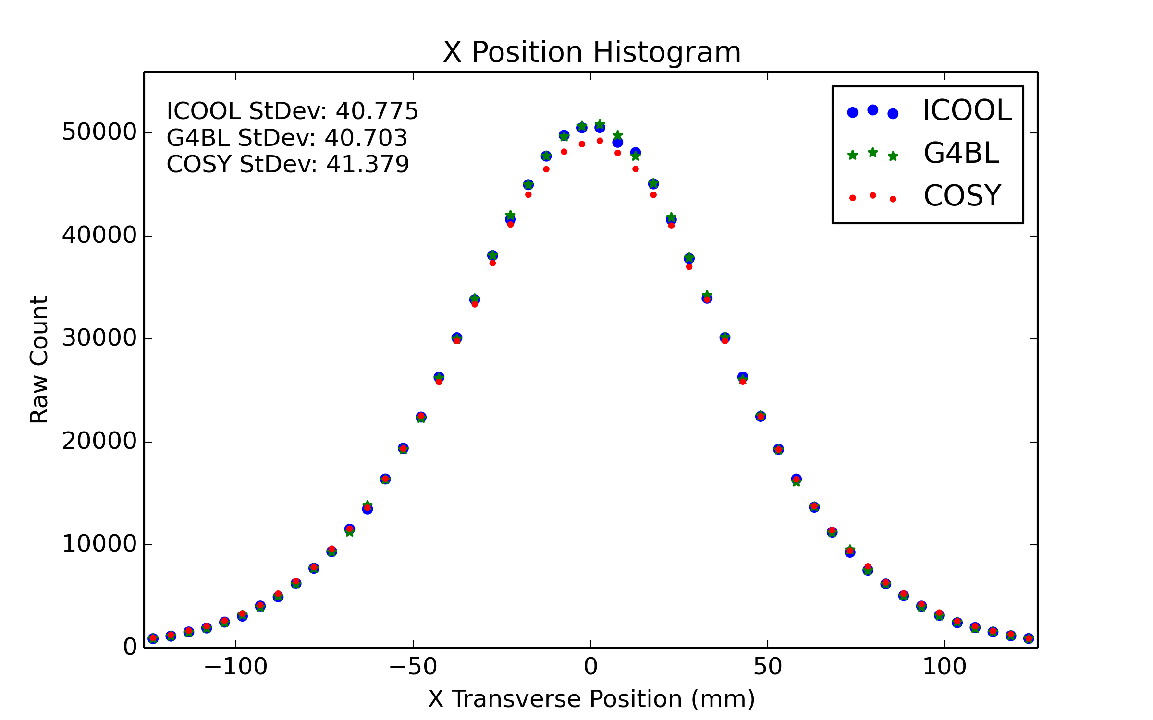
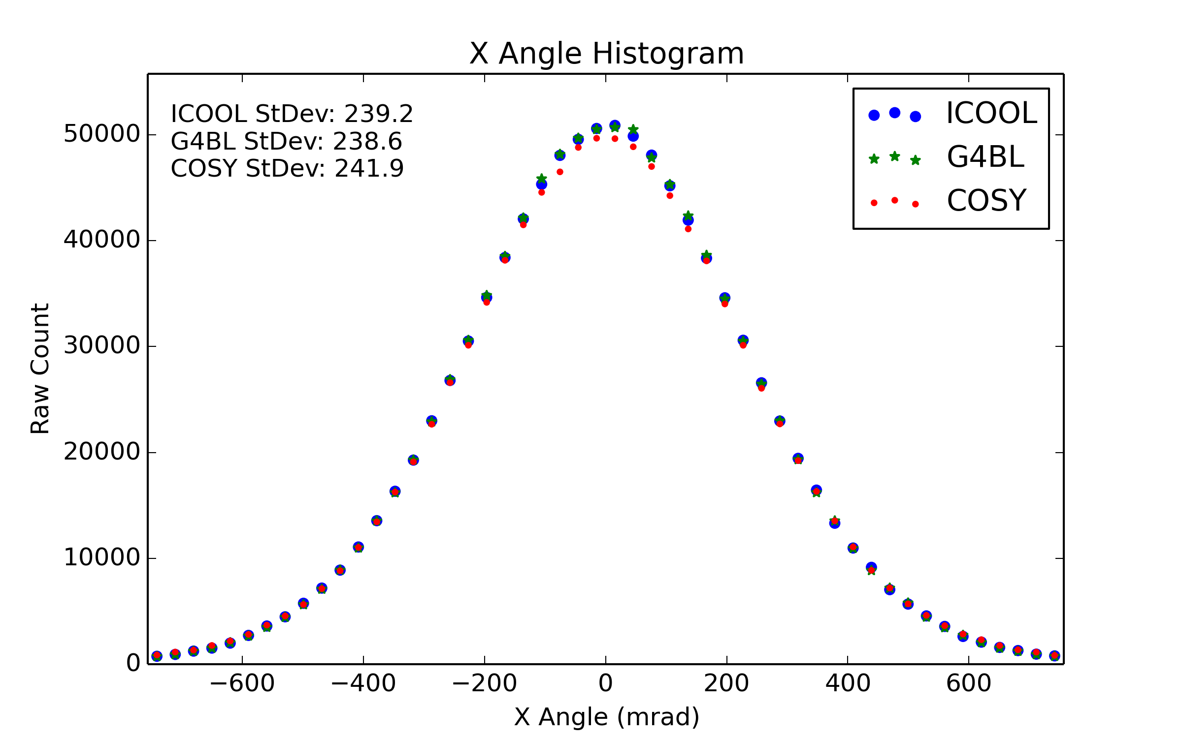
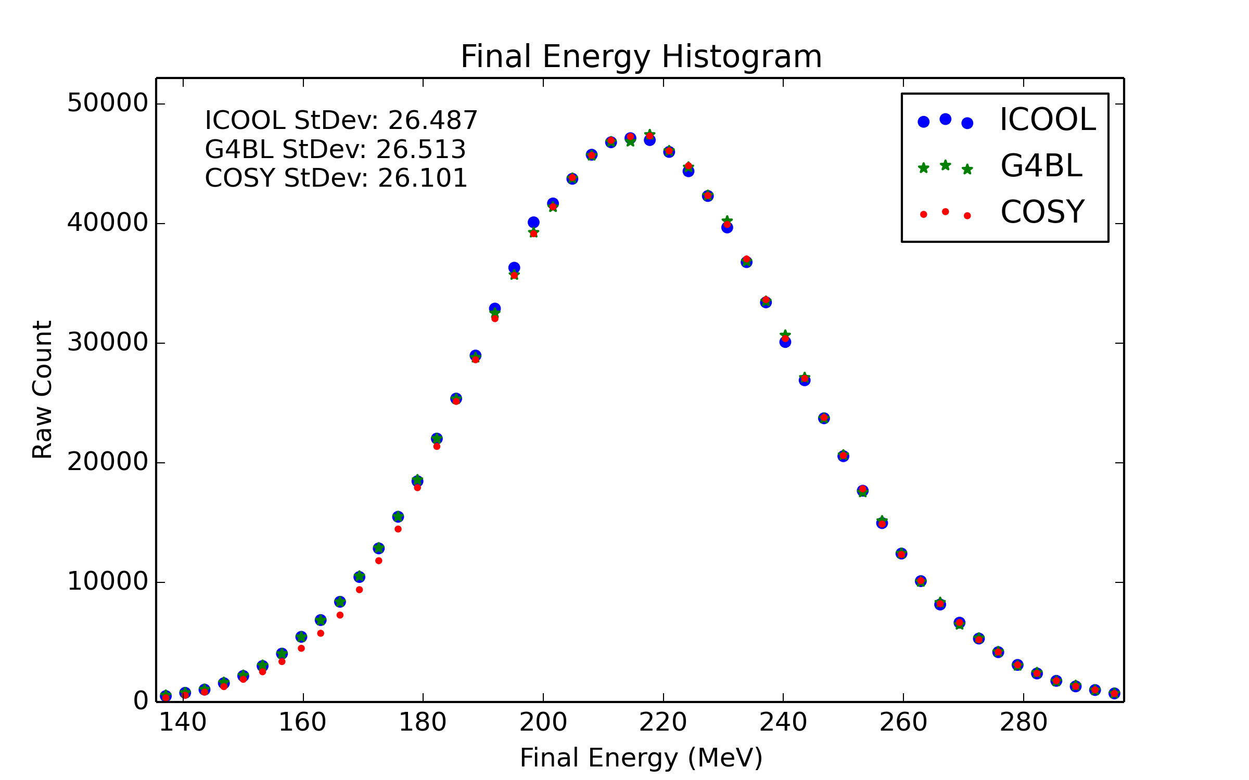

Slide 42
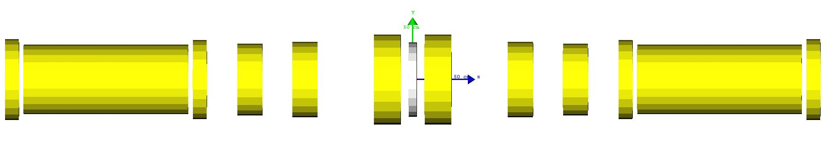
Results: MICE
Also simulated with 65 mm of lithium hydride
Agreement to within 1%

Slide 43
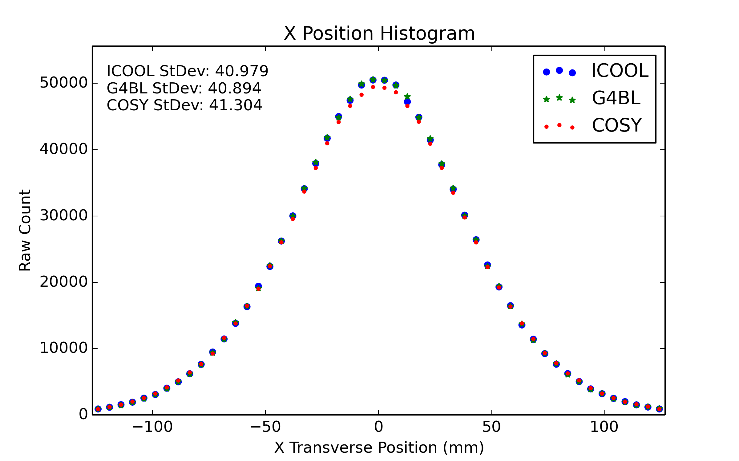
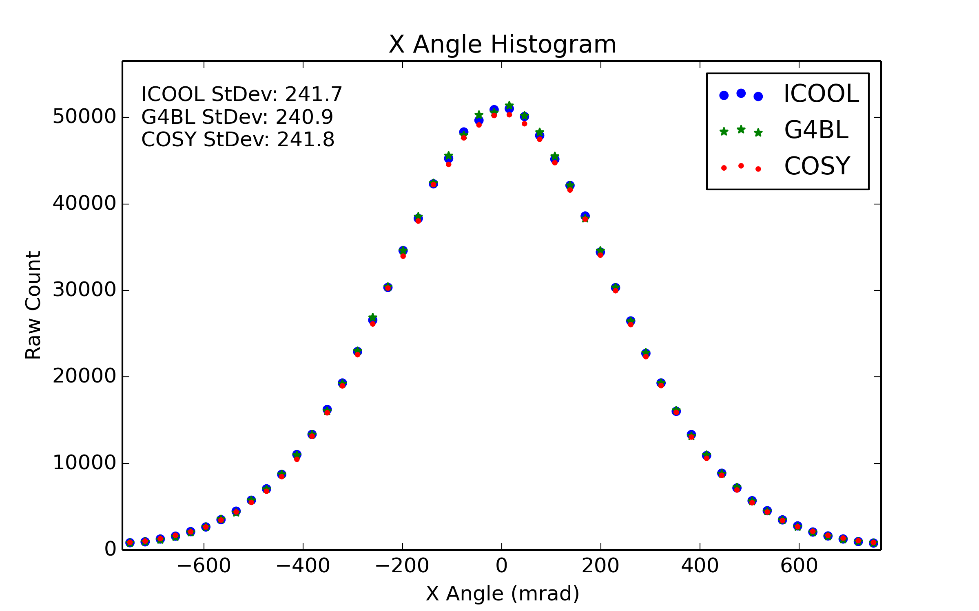
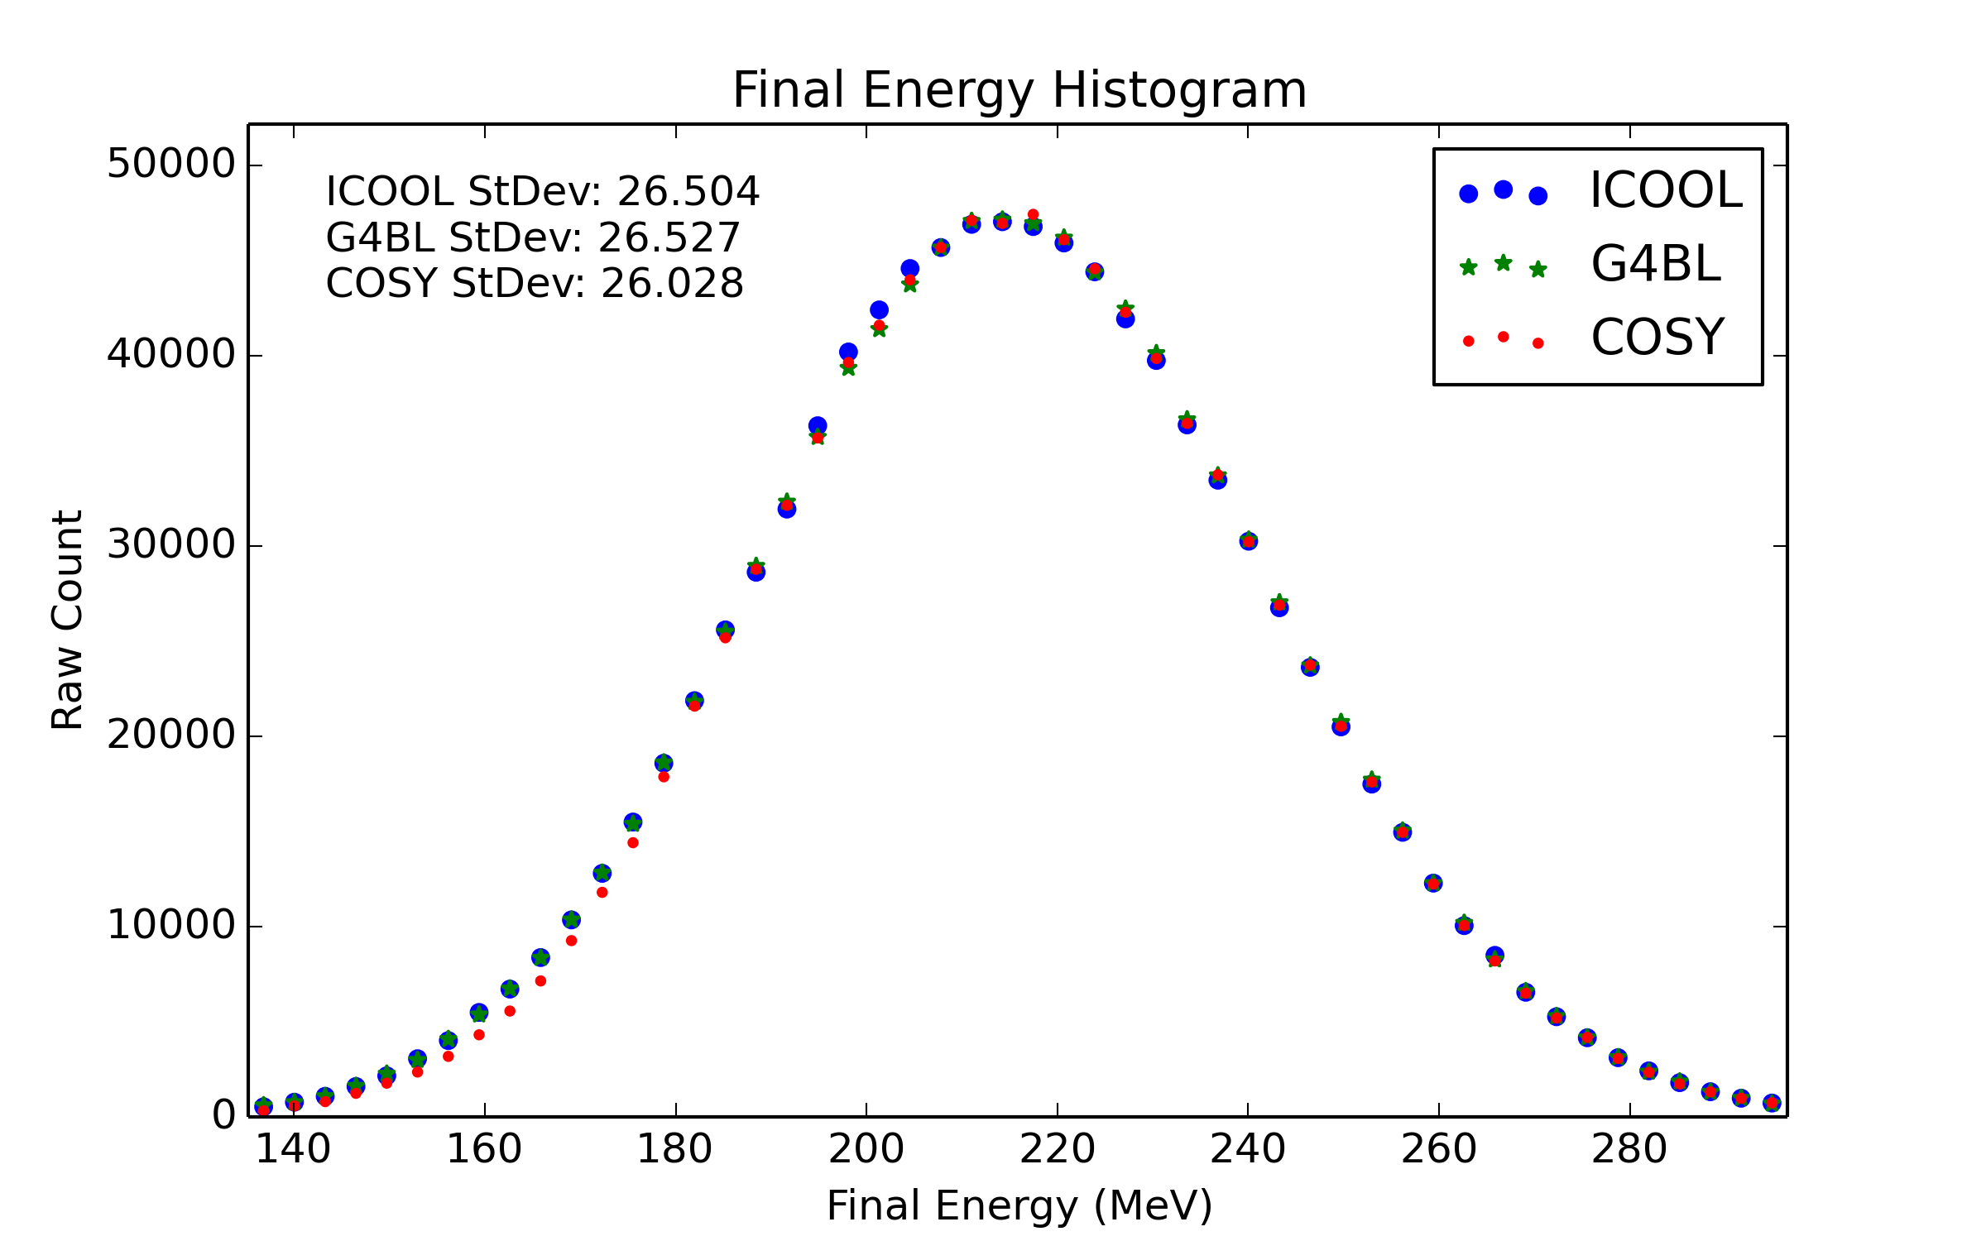

Slide 44

Results: MICE
Timed simulations for COSY, G4Beamline, and ICOOL
COSY roughly 50% the time of G4Beamline
COSY roughly 33% the time of ICOOL

Slide 45
Outline
Motivation
Fundamental particle physics
The Higgs Boson
Neutrinos
Muon facilities
Introduction to COSY Infinity
Transfer map methods
Transfer map example
Stochastic Processes
Ionization cooling
Why not use transfer maps?
Energy straggling
Multiple scattering
Transverse Displacement
Time-of-Flight
Results
Benchmarking
Validation
MICE
Summary

Slide 46
Summary
COSY Infinity is a simulations tool
COSY uses the transfer map method (fast)
New stochastic processes implemented into COSY Infinity for particle-by-particle propagation
First principle derivations to basic theory found in thesis
Corrections to basic theory novel in this work
Benchmarking shows agreement with ICOOL, G4Beamline
Validation shows agreement with MuScat results
Prediction of MICE Step IV results within 1% of other codes
Computation time for COSY twice as fast as other codes

Slide 47
Thank you!
(Questions?)

